Slide 1
Law, Culture and Community
Week 3
Our “self-evident” Truths

Slide 2
Law touches (just about) everything
How do you want to live?
Peacefully? Minimal hassle from your neighbors?
Independently?
Owner of a little/a lot of property?
Captain of your own ship? Author of your own life?
If you answered ‘yes’ to any of these questions, then LAW matters to you, and you belong in a community where you have a say in what your legal rights are and how they are protected.
A place to start … founding texts of the American political system

Slide 3
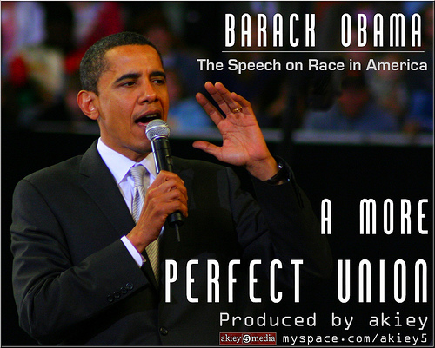
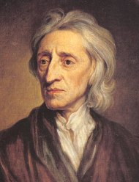
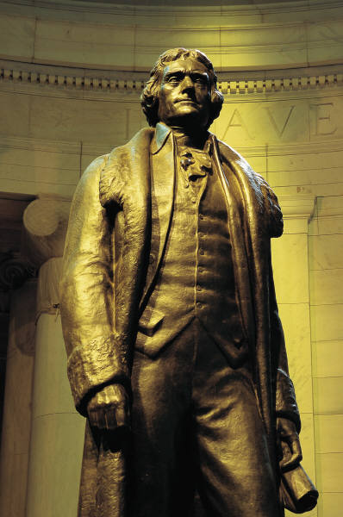
Back to the Future …
We hold these truths to be self-evident, that all men are created equal, that they
are endowed by their Creator with certain unalienable Rights … Life, Liberty and the pursuit of Happiness
LAW SHOULD GOVERN
… a government of laws and not of men
Fourscore and seven years ago our fathers brought forth on this continent a new nation, conceived in liberty and dedicated to the proposition that all men are created equal.

Slide 4
The Declaration of Independence (1776)
The unanimous Declaration of the thirteen united States of America,
When in the Course of human events, it becomes necessary for one people to dissolve the political bands which have connected them with another, and to assume among the powers of the earth, the separate and equal station to which the Laws of Nature and of Nature's God entitle them, a decent respect to the opinions of mankind requires that they should declare the causes which impel them to the separation.
We hold these truths to be self-evident, that all men are created equal, that they are endowed by their Creator with certain unalienable Rights, that among these are Life, Liberty and the pursuit of Happiness. -- That to secure these rights, Governments are instituted among Men, deriving their just powers from the consent of the governed, --

Slide 5
The US Constitution (1787)
We the People of the United States, in Order to form a more perfect Union, establish Justice, insure domestic Tranquility, provide for the common defence, promote the general Welfare, and secure the Blessings of Liberty to ourselves and our Posterity, do ordain and establish this Constitution for the United States of America.
******************************
Supreme law of the land
Separation of Powers – 3 branches of government
Principle of Federalism
Bill of Rights (original 10 amendments, 1791)

Slide 6
The Gettysburg Address, 1863
Four score and seven years ago our fathers brought forth on this continent, a new nation, conceived in Liberty, and dedicated to the proposition that all men are created equal.
Now we are engaged in a great civil war, testing whether that nation, or any nation so conceived and so dedicated, can long endure. We are met on a great battle-field of that war. We have come to dedicate a portion of that field, as a final resting place for those who here gave their lives that that nation might live. It is altogether fitting and proper that we should do this.
But, in a larger sense, we can not dedicate -- we can not consecrate -- we can not hallow -- this ground. The brave men, living and dead, who struggled here, have consecrated it, far above our poor power to add or detract. The world will little note, nor long remember what we say here, but it can never forget what they did here. It is for us the living, rather, to be dedicated here to the unfinished work which they who fought here have thus far so nobly advanced. It is rather for us to be here dedicated to the great task remaining before us -- that from these honored dead we take increased devotion to that cause for which they gave the last full measure of devotion -- that we here highly resolve that these dead shall not have died in vain -- that this nation, under God, shall have a new birth of freedom -- and that government of the people, by the people, for the people, shall not perish from the earth.

Slide 7
What can we say about these texts?
They are really old with weird spelling.
Teachers have talked about them since 2nd grade.
Apparently, some genius old (dead) white guys figured something out about how to organize a democratic government that nobody seems to have improved on in over 200 years.
The design for a “more perfect union” started out pretty imperfectly – lots of people invisible …
And yet, they have given us our central civic values and culture: Liberty, Equality, Justice

Slide 8
The Declaration of Independence: Liberty as our defining core value, our “self-evident truth”
America is founded on an idea of self-determination.
Enlightenment concept of ‘universality’ – all persons are created equal AND no one person is the source of our rights, our rights are endowed by a ‘higher Power, a Creator.’ (Locke)
Jefferson greatly influenced by John Locke with formulation of “unalienable rights” being “life, liberty, and pursuit of happiness” – Locke had “estate” instead of “happiness.”
“Life, Liberty, and the pursuit of happiness” is considered by some as part of one of the most well crafted, influential sentences in the English language. (Wikipedia)
Even though we are endowed with ‘natural rights,’ the DoI anticipates a central role for government (positive law) for securing these rights … but how?

Slide 9
And again … the US Constitution: Justice as “Fair Process” embodied in the Rule of Law?
“In order to form a more perfect Union …”
A legal document establishing a form of government and the institutions for a political process that could translate the promise of natural rights in the DoI into civic reality.
Struggles over the substance of the ‘natural rights’ guaranteed by the Constitution contribute to the ongoing ‘perfection of our Union
A ‘living document’ or on ‘life support’?

Slide 10
The Gettysburg Address: Lincoln’s re-imagining our nation’s purpose … Liberty and Equality
Where do we get our national concern for the political and legal value of “equality under law”?
The Declaration of Independence does not proclaim equality to be an inalienable right, nor does it specify that human government has any responsibility to protect or promote equality. Rather, equality is a starting point for the human condition due to divine will.
The Gettysburg Address is the first political canonical document to assert that America as a nation is “dedicated to the proposition that all men are created equal.”
Lincoln is attempting to change our self-conception – he’s elevating the value of equality above liberty.

Slide 11
Liberty, Equality, Justice
LAW
Key concepts: Liberty, Equality, Justice
US political system founded on RULE OF LAW
Citizens:(personal) Rights & (governance) Duties
CULTURE
Key concepts: Liberty, Equality, Justice
Law as the “air we breathe” in democracy
Representations and contestations of our collective and individual identity – in law texts and in art
COMMUNITY
Key concepts: Liberty, Equality, Justice
E Pluribus Unum – “Out of many, one”
Collective, ongoing debate on what justice requires of law

Slide 12
Where do our ‘natural rights’ come from?
The Big 3: Liberty, Equality, Justice
Community: Our “union” protects our “individual rights”
Culture: “Enshrined” in the Declaration of Independence
Law: Provided for in the US Constitution
What about the idea of Fairness? Process v. Substance
What’s the relationship between L,E,J and our attraction to procedural Fairness, to ‘playing by the rules,’ to ‘free and fair elections,’ to ‘our day in court.’
How do we figure out what are natural rights are when we disagree about their content?

Slide 13
Checking in: Law, Culture & Community in the US
The US is a political entity (re)founded on the ideals of liberty, equality and justice.
Liberty, Equality, Justice – vital, lofty, difficult, essential, beautiful
Fairness – a key concept we use to evaluate our progress on L,E,J concerns
Who we are through the lens of political and legal struggle:
How do we sort out the meaning of our “natural rights” to liberty, equality, and justice when we disagree over how these rights are defined or what these rights entail?
How do we come up with a collective understanding of the substance of these natural rights? (Spoiler alert: The political process is a constant working out of the substance of our legal rights)
How are concepts of community shaped and challenged in these struggles?
How are concepts of individual identity shaped and challenged?

